Slide 1
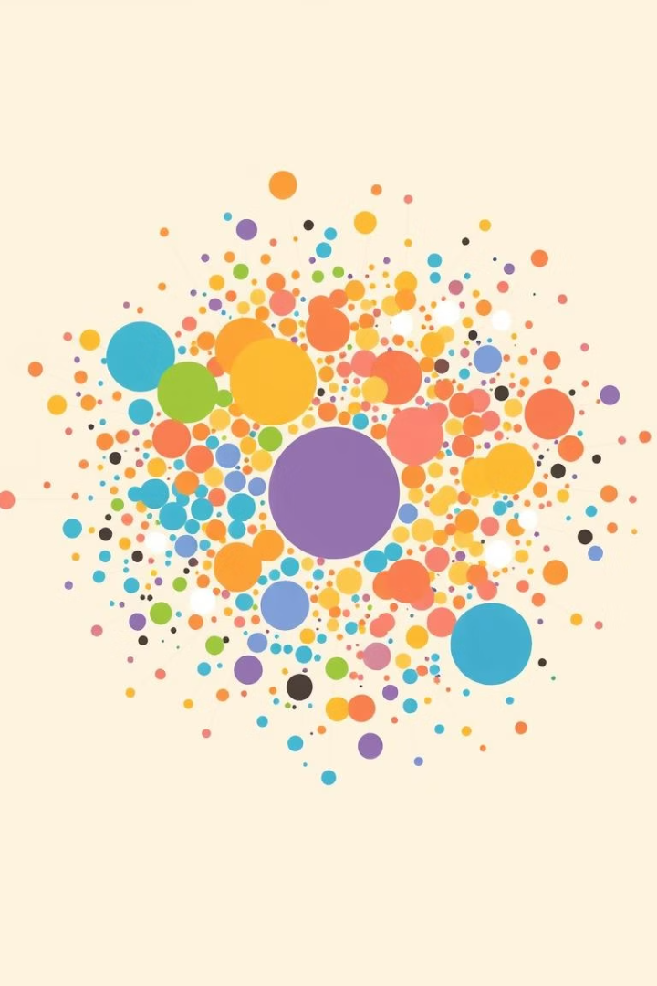
Customer Segmentation with Clustering: A Data-Driven Approach
Unlock customer insights with advanced clustering techniques. This presentation explores how data-driven methods revolutionize segmentation for marketing success.

Slide 2
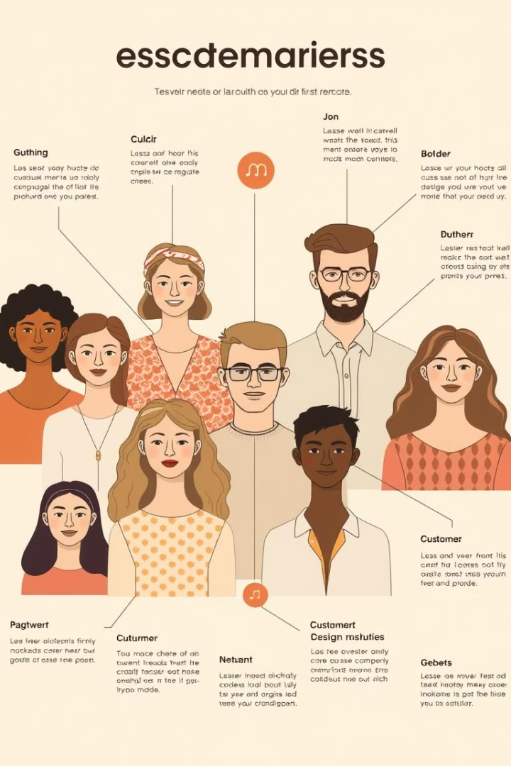
What is Customer Segmentation?
Definition
Dividing customers into groups with shared traits.
Purpose
Customize marketing, product, and support strategies.
Methods
Traditional vs. data-driven clustering approaches.
Example
Grouping by purchase patterns and demographics.

Slide 3
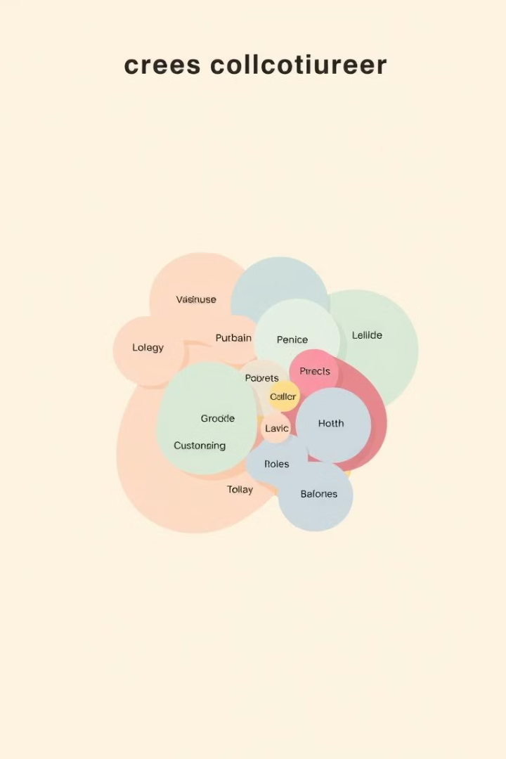
Why Use Clustering for Segmentation?
Reveal Hidden Patterns
Uncover insights not obvious in raw data.
Personalize Marketing
Improve ROI by targeting relevant segments.
Identify Valuable Customers
Focus efforts on high-value groups.
Real Impact
Example: Boost sales by 20% with targeted promotions.

Slide 4
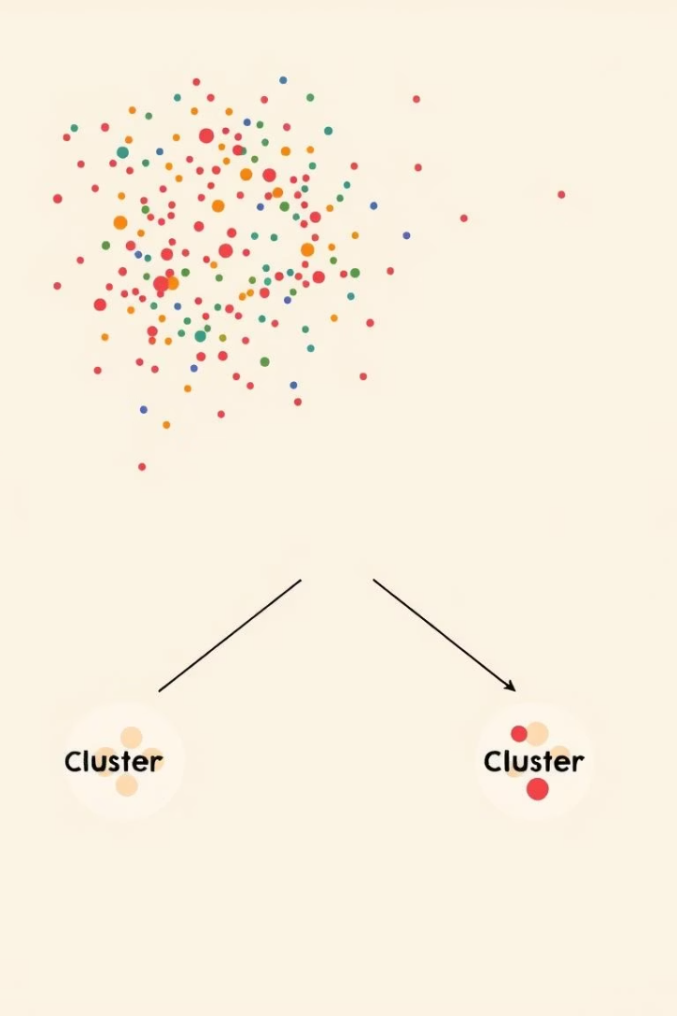
Introduction to K-Means Clustering
How It Works
Partition data into k clusters minimizing variance.
Process
Initialization
Assignment
Update
Convergence
Evaluation
Use elbow and silhouette methods to choose k.
Example
Selecting optimal clusters based on business needs.

Slide 5
Exploratory Data Analysis (EDA)
Understand Data
Tools & Techniques
Importance
Example
Analyze distributions, correlations, and outliers.
Histograms
Identify key variables and prepare data for clustering.
Age and income show strong correlation in customers.
Scatter plots
Correlation matrices

Slide 6
Feature Engineering and Selection
Create Features
Select Features
Dimensionality Reduction
Example
Derive Recency, Frequency, Monetary (RFM) values.
Pick relevant features to improve clustering.
Convert purchase dates into “days since last buy.”
Use PCA to simplify data without losing info.

Slide 7
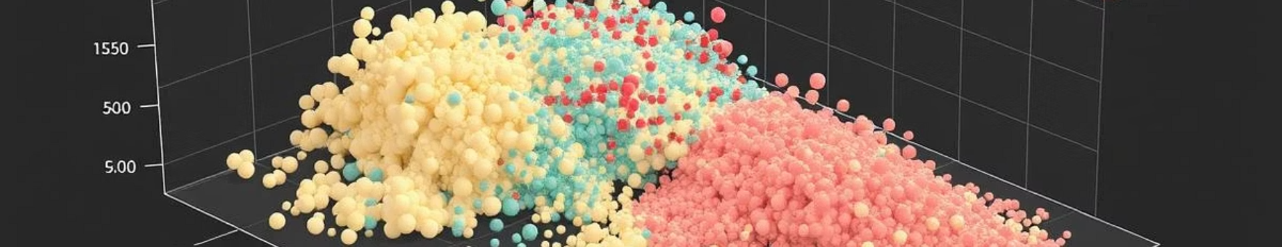
Principal Component Analysis (PCA)
Purpose
Identify Components
Reduce data dimensions while preserving variance.
Extract factors explaining most of the data.
Use in Clustering
Example
Input principal components instead of raw data.
Reduce 20 features to 5 main components.

Slide 8
Applying K-Means Clustering
Determine k
1
Use elbow and silhouette methods for optimal clusters.
Run Algorithm
2
Apply K-Means on selected features.
Analyze Clusters
3
Profile customer groups by behavior and demographics.
Example
4
Segments named “Loyal,” “Potential Loyalists,” and “New Customers.”

Slide 9
Interpreting and Visualizing Clusters
Create Profiles
Data Visualization
Marketing Strategy
Example
Define characteristics of each cluster.
Display clusters clearly with plots and charts.
Design campaigns tailored to each segment.
Loyal customers get discounts; new ones get onboarding emails.

Slide 10

Actionable Insights and Conclusion
Personalized Experiences
Segmentation drives customer engagement and satisfaction.
Marketing Impact
Boost effectiveness and ROI with targeted campaigns.
Ongoing Process
Continuously monitor and refine segments for growth.
Next Steps
Implement clustering, test campaigns, and analyze results.

